Slide 1
Data Communication & Networks
Chapter 1: Introduction

Slide 2
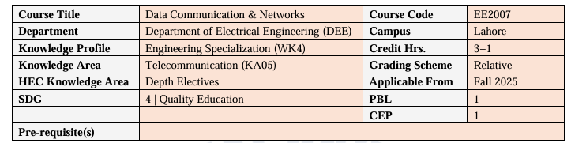
Course Basic Information

Slide 3
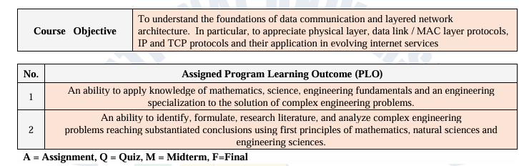
Course Basic Information

Slide 4
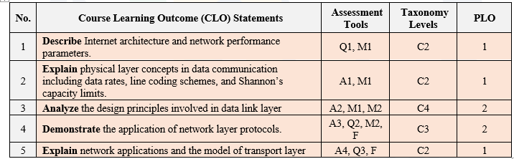
Course Basic Information

Slide 5
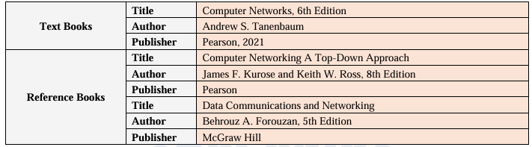
Course Basic Information

Slide 6
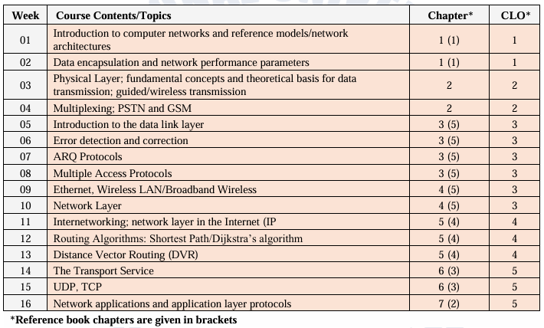
Course Basic Information

Slide 7

Course Basic Information

Slide 8
Course Basic Information

Slide 9
Course Basic Information
Why Study This Course?

Slide 10
Motivation
High Global Demand & Lucrative Jobs Network Engineer roles are among the most sought-after in the tech
industry.
In the U.S., network engineers earn between $77K – $100K annually, with total compensation (including bonuses and equity) reaching $118K
In Google, network engineers make between $108K – $195K per year
https://www.coursera.org/articles/network-engineer

Slide 11
Motivation
Strong Career Path in Pakistan
Top-tier Firms like IBEX: Initial pay starts from PKR. 60k to 125k/month.
Global Standards Bodies in Networking:
IETF (Internet Engineering Task Force): Defines protocols like HTTP, TCP/IP,
DNS.
IEEE: Develops standards for Ethernet, Wi-Fi, networking hardware.
ITU-T (International Telecommunication Union – Standards)

Slide 12

Motivation
https://www.youtube.com/watch?v=awbjTC31LIY
https://myimpactmeter.com/about-us-mim/

Slide 13
Course Basic Information
Instructions to study DCN?

Slide 14
Course Basic Information
Attend all the classes.
Come in-time.
Be attentive in Class.
Prohibit chatting and any other distractions.

Slide 15
Chapter 1: Introduction
Chapter 1 : Introduction

Slide 16
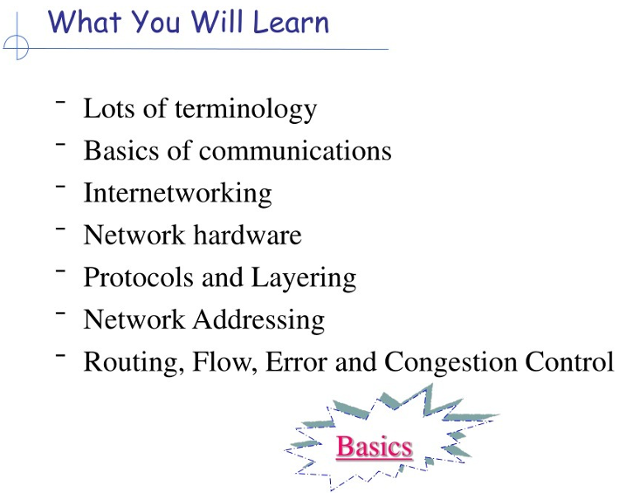
Introduction

Slide 17
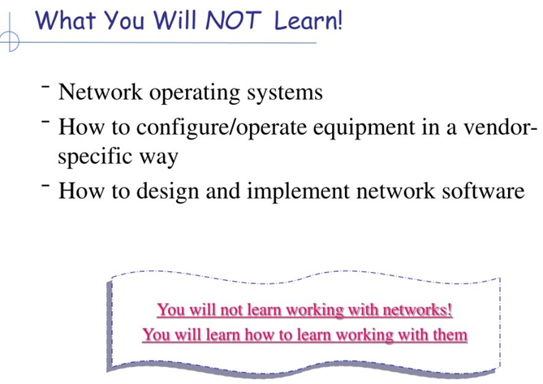
Introduction

Slide 18
Introduction
What is Computer Networks?
A computer network is a system in which two or more computers (or devices) are connected together to share resources, exchange data, and communicate with each other. These connections can be established through wired (like Ethernet cables) or wireless (like Wi-Fi, Bluetooth) methods.

Slide 19
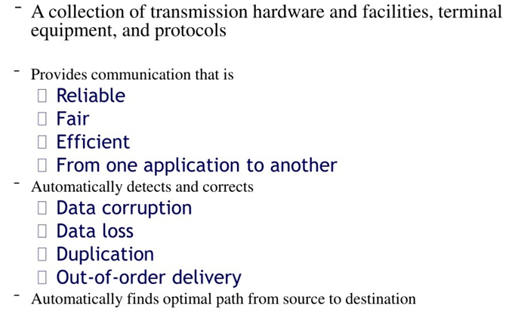
Introduction

Slide 20
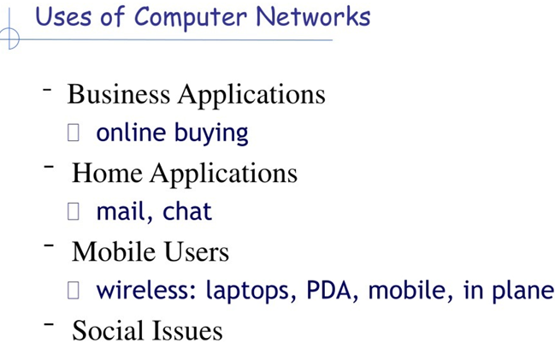
Introduction

Slide 21
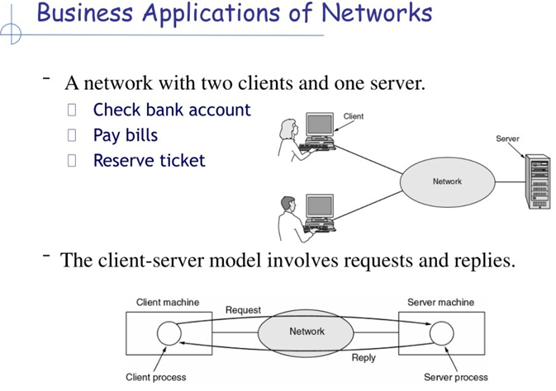
Introduction
Client-Server Model

Slide 22
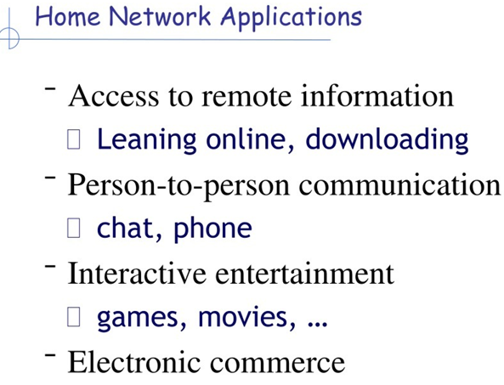
Introduction

Slide 23
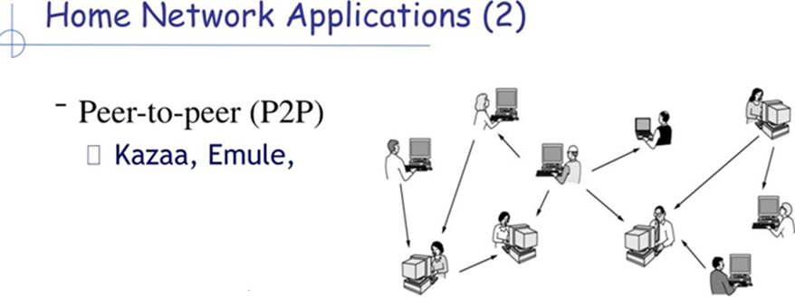
Introduction
Peer-to-Peer (P2P) Communication
Peer-to-peer communication is a network model where two or more computers (called peers) communicate directly with each other without needing a central server.
Each peer in this system is both a client (requesting resources) and a server (providing resources).

Slide 24
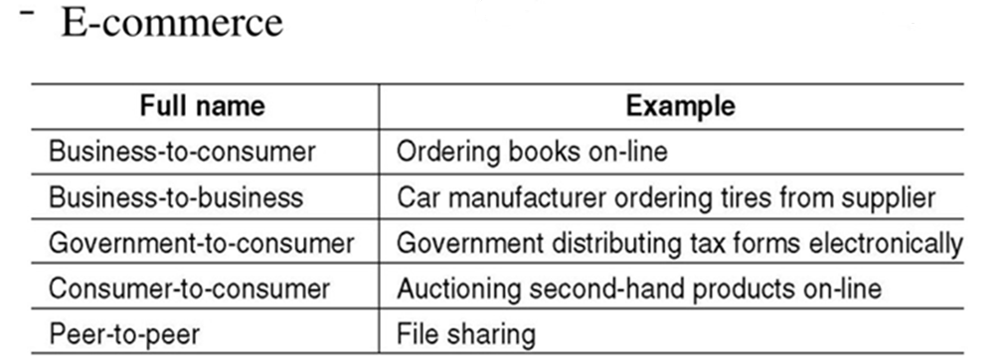
Introduction: Home Network Applications

Slide 25
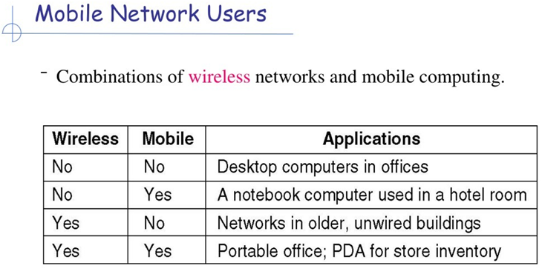
Introduction

Slide 26
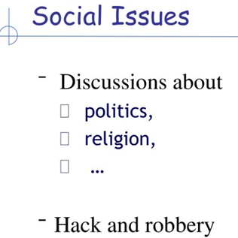
Introduction

Slide 27
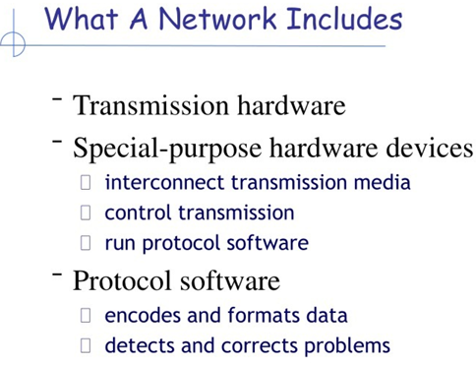
Introduction

Slide 28
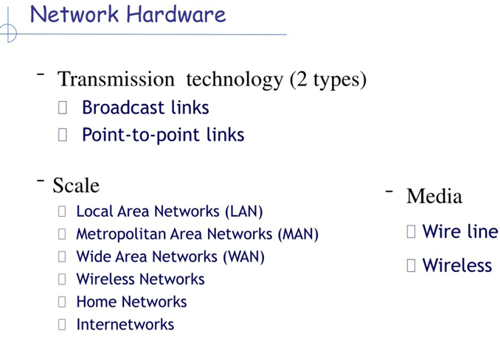
Introduction

Slide 29
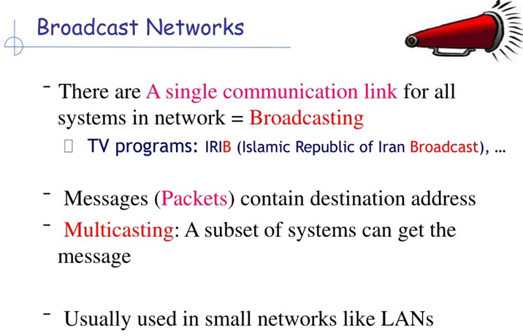
Introduction

Slide 30
Introduction
Point-to-Point Communication
Point-to-Point (P2P) is a type of network connection where data travels directly between two specific devices (or nodes) over a dedicated link.
It is like having a private line between two devices, with no intermediaries.
Examples
Telephone call between two people (traditional landline).
Serial cable connection between a computer and a printer.
Direct Wi-Fi link (ad-hoc mode) between two laptops.

Slide 31
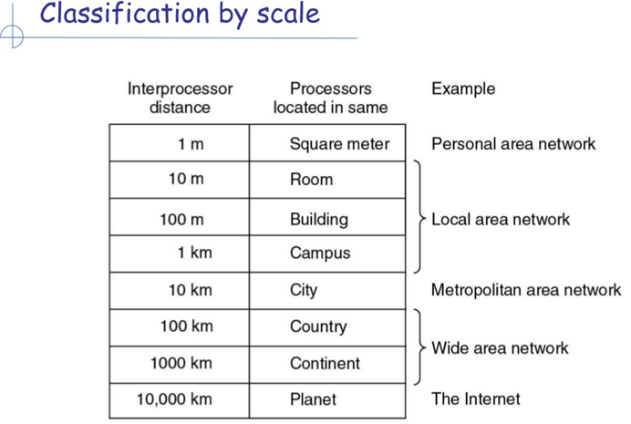
Introduction

Slide 32
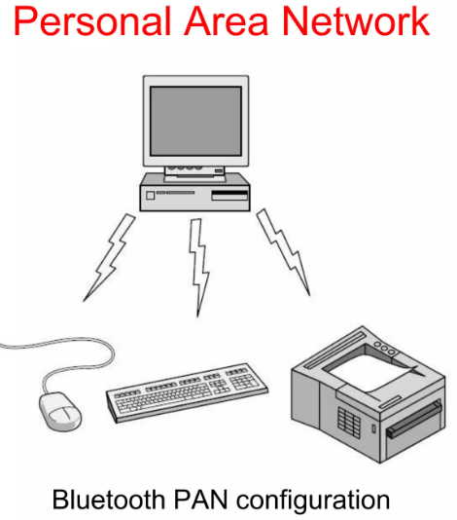
Introduction

Slide 33
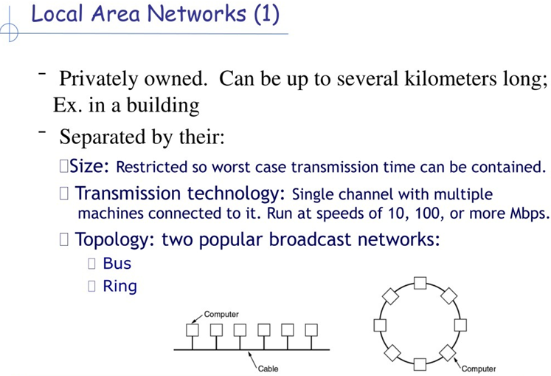
Introduction

Slide 34
Introduction
Must read Bus and Ring topology from the following link
https://www.geeksforgeeks.org/computer-networks/difference-between-ring-topology-and-bus-topology-in-computer-networks/

Slide 35
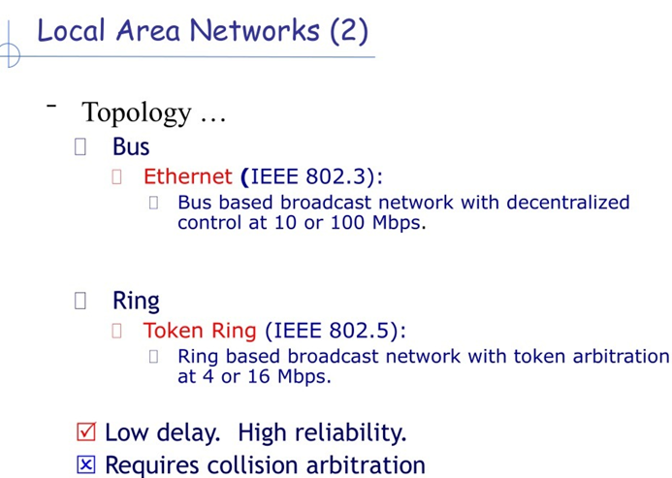
Introduction

Slide 36
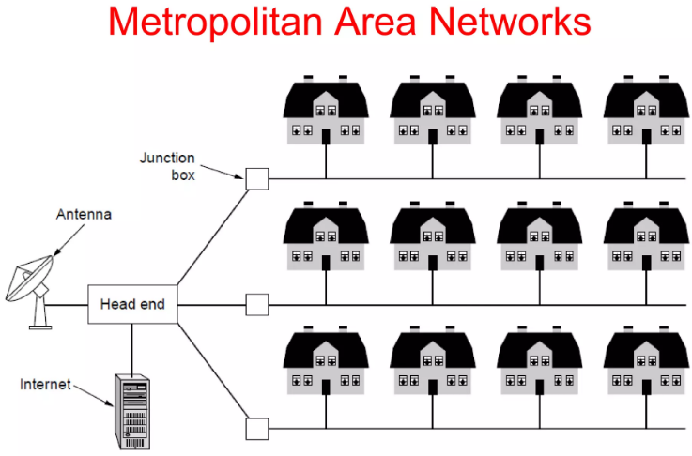
Introduction
Application: Modern day Cable TV System

Slide 37
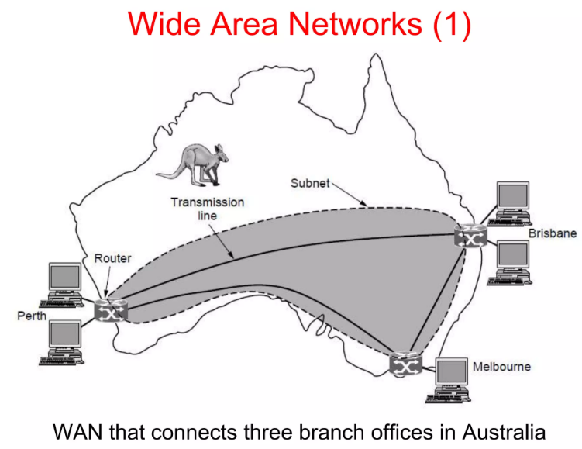
Introduction
End devices/Machines are called Hosts.

Slide 38
Introduction
End devices/Machines are called Hosts
Communication Subnet: The rest of the network that connects these hosts
Subnet consists of Switches/Routers and transmission lines

Slide 39
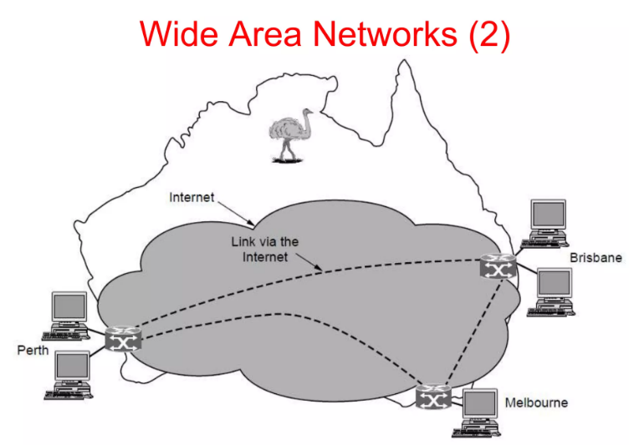
Introduction
Virtual Private Networks.

Slide 40
Introduction
Virtual Private Networks.

Slide 41
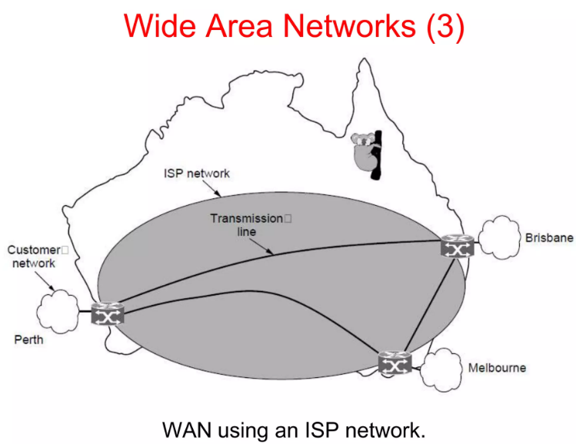
Introduction
Interconnected Networks: ISP(Internet Services Provider)

Slide 42
Introduction
Interconnected Networks: ISP(Internet Services Provider)
Internetworks are the combination of Interconnected networks

Slide 43
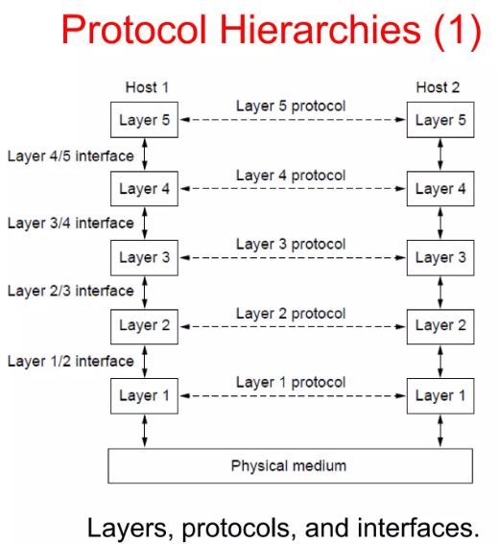
Introduction
Protocols: Agreement between two communicating parties

Slide 44
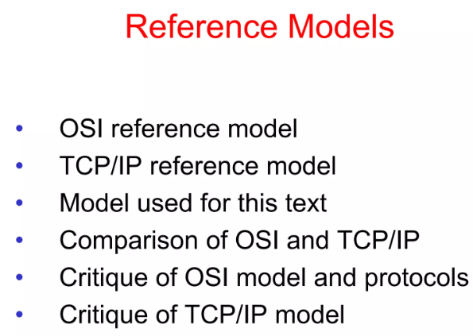
Introduction

Slide 45
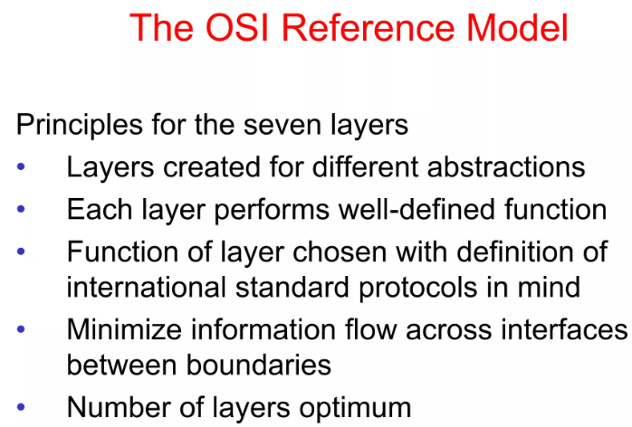
Introduction

Slide 46
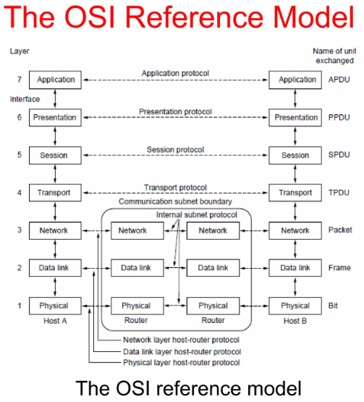
Introduction

Slide 47
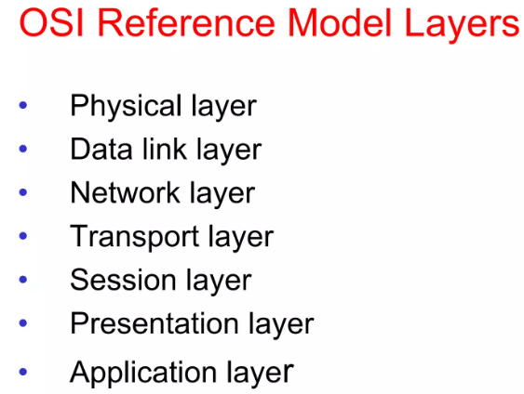
Introduction

Slide 48
Introduction: Physical Layer
Physical Layer: Responsible for transmitting data over the communication medium/channel.
Data transfer in form of bytes (0 or 1)
Data transfer from one network to other network

Slide 49
Introduction: Data Link Layer
Data Link Layer: Break down the data into data frames (a division of few hundred or thousand bytes)
Detect and remove errors in Bytes (Transmission error)
Medium access control layer.

Slide 50
Introduction: Network Layer
Network Layer: Delivery of individual packets from the source host to the destination host of other network.
Same network transmission skip Network Layer
Add Logical Addressing schemes.

Slide 51
Introduction: Transport Layer
Transport Layer: Delivery of a complete message from one process to another process.
Message from Session layer to Network Layer and Network Layer to Session layer
Error control and Flow control.

Slide 52
Introduction: Session Layer
Transport Layer: Establishes, maintains, and synchronizes the interaction (connection) among communicating systems.
Dialog Control: Half-duplex mode or Full-duplex mode.
Synchronization: Add checkpoints to check received and acknowledged messages.

Slide 53
Introduction: Presentation Layer
Presentation Layer: syntax and semantics of the information exchanged between two networks
Translation: Machine language (Bits).
Compression: Reduces number of bits for transmission.
Encryption/ Decryption: Messages into secure form.

Slide 54
Case Study as an Example
Focus on White Board and Lecture

Slide 55
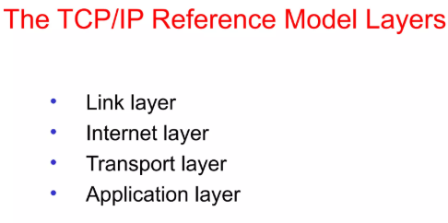
Introduction: TCP/IP Reference Model

Slide 56
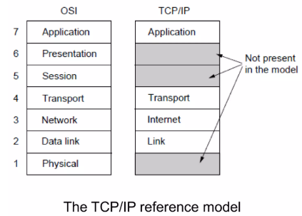
Introduction: TCP/IP Reference Model

Slide 57
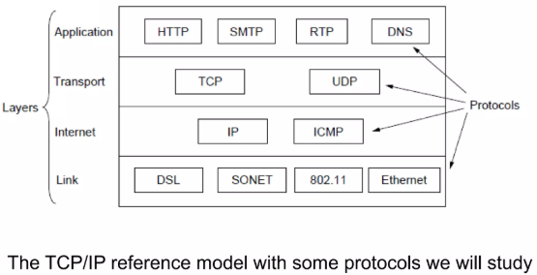
Introduction: TCP/IP Reference Model

Slide 58
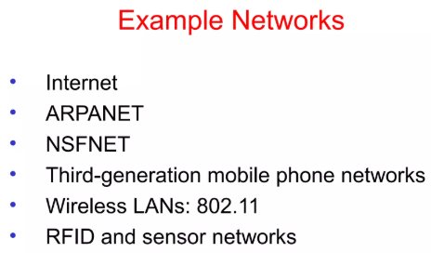
Introduction: Types of Computer Networks

Slide 59
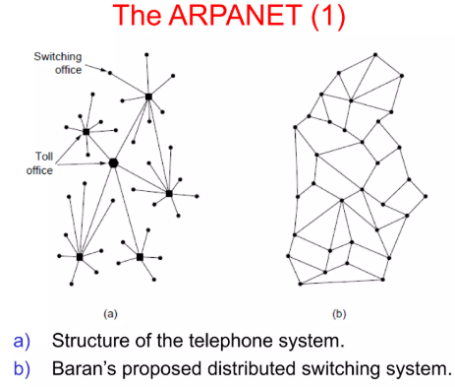
Introduction: Types of Computer Networks

Slide 60
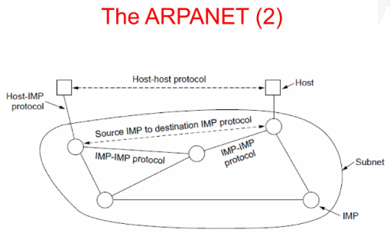
Introduction: TCP/IP Reference Model

Slide 61
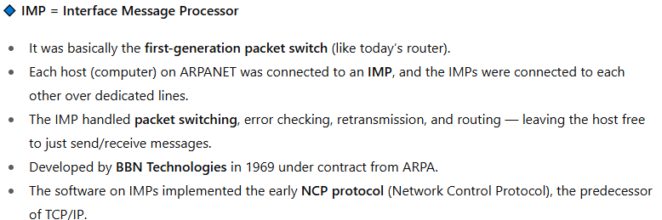
Introduction: TCP/IP Reference Model

Slide 62
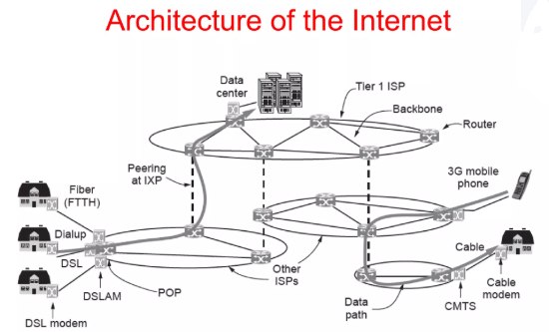
Introduction: Types of Computer Networks

Slide 63
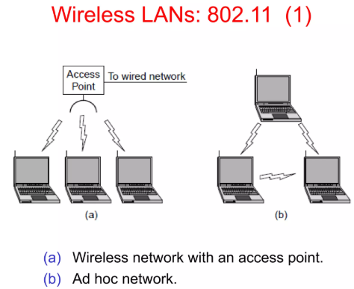
Introduction: Types of Computer Networks

